Slide 1
Chapter 2.3 Creating High-Quality Code
CCSW 325 (Software Construction)
Notes:
Last Update: 22/8/2019
Version 1.0

Slide 2
2- Creating High-Quality Code [3]

Slide 3
Outline
Design in Construction – Part 2 of 2​
Design Building Blocks: Heuristics​
Design Practices

Slide 4
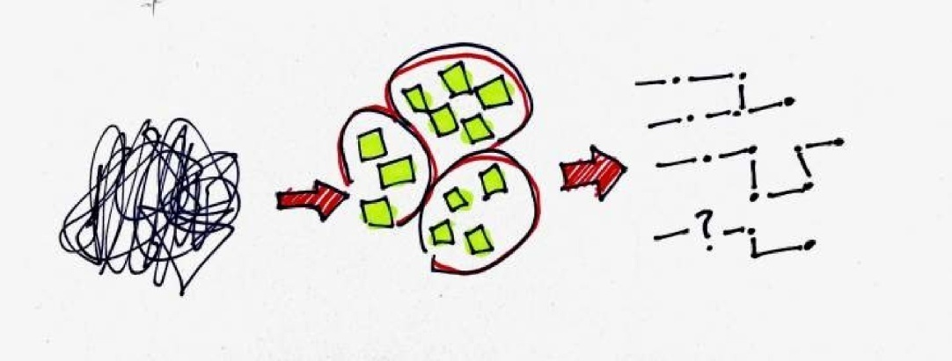
Design Building Blocks: Heuristics
Because design is nondeterministic, skillful application of an effective set of heuristics is the core activity in good software design​
GOAL: Minimal Complexity

Slide 5
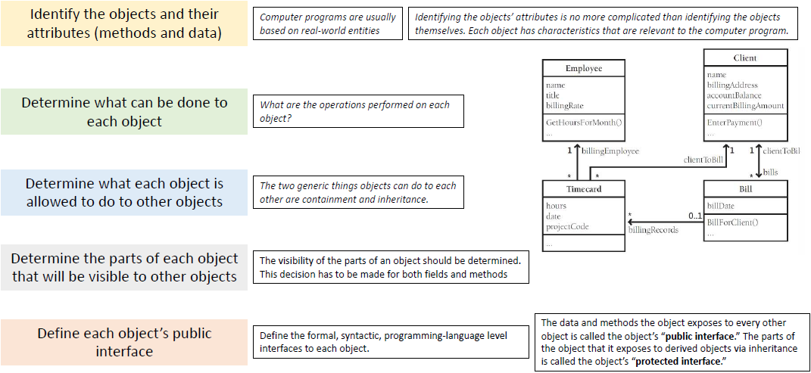
Design Heuristics : Find Real-World Objects

Slide 6

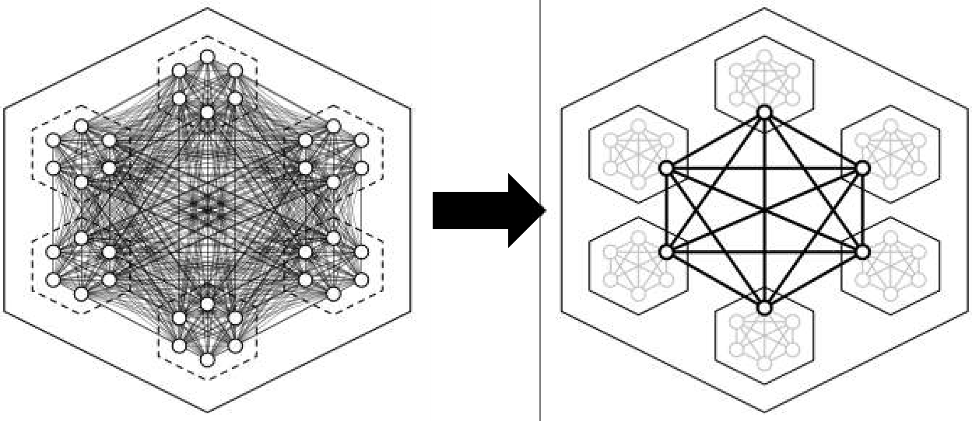
Design Heuristics : Form Consistent Abstractions
Abstraction is the ability to engage with a concept while safely ignoring some of its details
From a complexity point of view, the principal benefit of abstraction is that it allows you to ignore irrelevant details
Good programmers create abstractions at the routine-interface level, class-interface level, and package-interface level

Slide 7

Design Heuristics : Encapsulate Implementation Details
Encapsulation picks up where abstraction leaves off. It helps managing complexity by forbidding you to look at the complexity.
Encapsulation says that, not only are you allowed to take a simpler view of a complex concept, you are not allowed to look at any of the details of the complex concept.
What you see is what you get—it’s all you get!

Slide 8

Design Heuristics: Inherit
Inheritance is one of object-oriented programming’s most powerful tools. It can provide great benefits when used well, and it can do great damage when used naively.
Object-oriented programming allows classes to inherit commonly used state and behavior from other classes and let you focus on the features that make a specific class unique

Slide 9
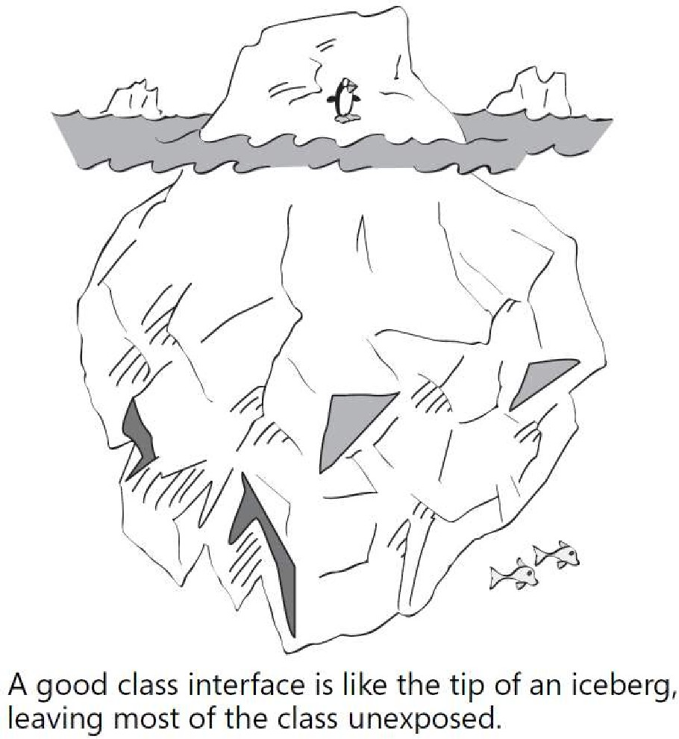
Design Heuristics: Hide Secrets (Information Hiding)
Information hiding gives rise to the concepts of encapsulation and modularity and it is associated with the concept of abstraction.

Slide 10
Design Heuristics: Identify Areas Likely to Change
Accommodating changes is one of the most challenging aspects of good program design. The goal is to isolate unstable areas so that the effect of a change will be limited to one routine, class, or package
Identify items that seem likely to change
Separate items that are likely to change
Isolate items that seem likely to change
Business rules
Hardware dependencies
Input and output
Nonstandard language features
Difficult design and construction areas
Status variables
Data-size constraints
Areas Likely to Change
A good technique for identifying areas likely to change is first to identify the minimal subset of the program that might be of use to the user. The subset makes up the core of the system and is unlikely to change.

Slide 11
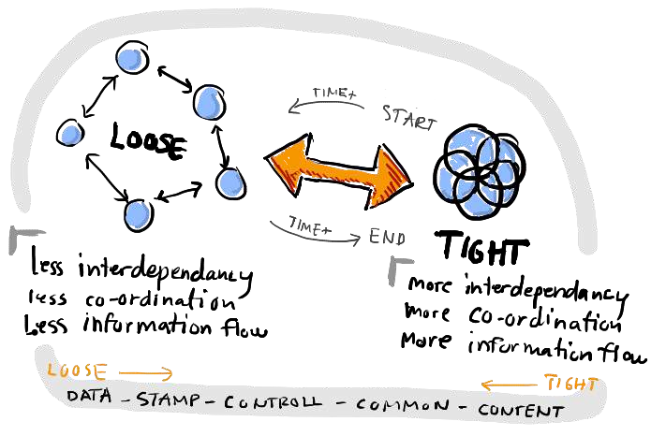
Design Heuristics: Keep Coupling Loose
Coupling describes how tightly a class or routine is related to other classes or routines.
The goal is to create classes and routines with small, direct, visible, and flexible relations to other classes and routines, which is known as “loose coupling.
Coupling Criteria | Size
 | Visibility
 | Flexibility
Kinds of Coupling
Simple-data-parameter coupling
Classes and routines are first and foremost intellectual tools for reducing complexity. If they’re not making your job simpler, they’re not doing their jobs.
Simple-object coupling
Object-parameter coupling
Semantic coupling
Notes:
Simple-data-parameter coupling Two modules are simple-data-parameter coupled if all the data passed between them are of primitive data types and all the data is passed through parameter lists. This kind of coupling is normal and acceptable
Simple-object coupling A module is simple-object coupled to an object if it instantiates that object. This kind of coupling is fine
Object-parameter coupling Two modules are object-parameter coupled to each other if Object1 requires Object2 to pass it an Object3. This kind of coupling is tighter than Object1 requiring Object2 to pass it only primitive data types because it requires Object2 to know about Object3
Semantic coupling The most insidious kind of coupling occurs when one module makes use not of some syntactic element of another module but of some semantic knowledge of another module’s inner workings. Here are some examples: ■ Module1 passes a control flag to Module2 that tells Module2 what to do. This
approach requires Module1 to make assumptions about the internal workings of
■ Module2, namely what Module2 is going to do with the control flag. If Module2
defines a specific data type for the control flag (enumerated type or object), this
usage is probably OK.
■ Module2 uses global data after the global data has been modified by Module1.
This approach requires Module2 to assume that Module1 has modified the data
in the ways Module2 needs it to be modified, and that Module1 has been called at
the right time.

Slide 12
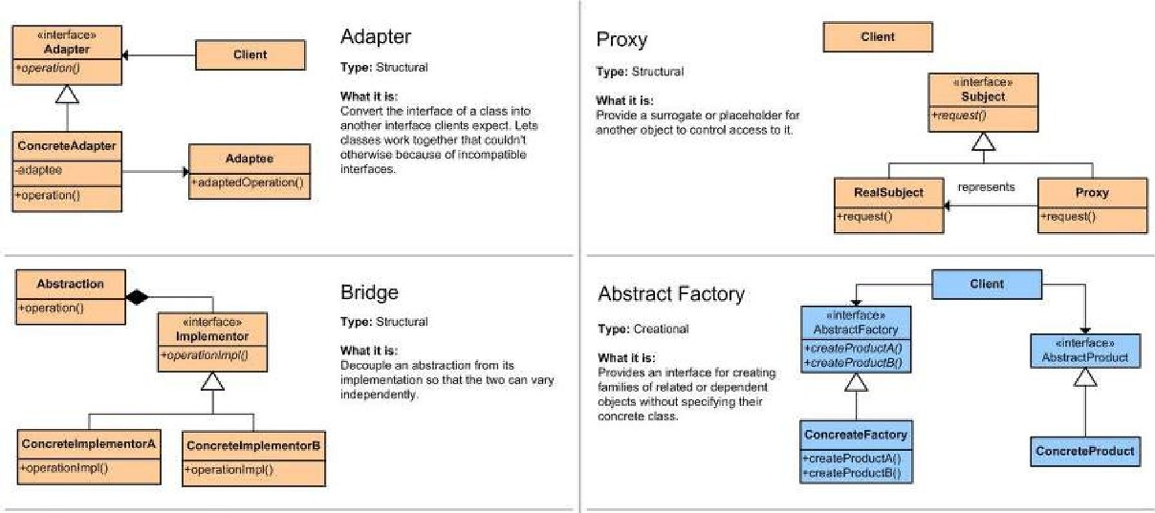
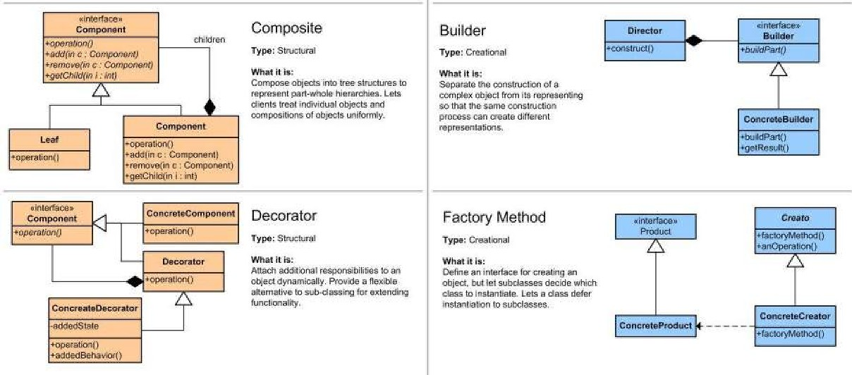
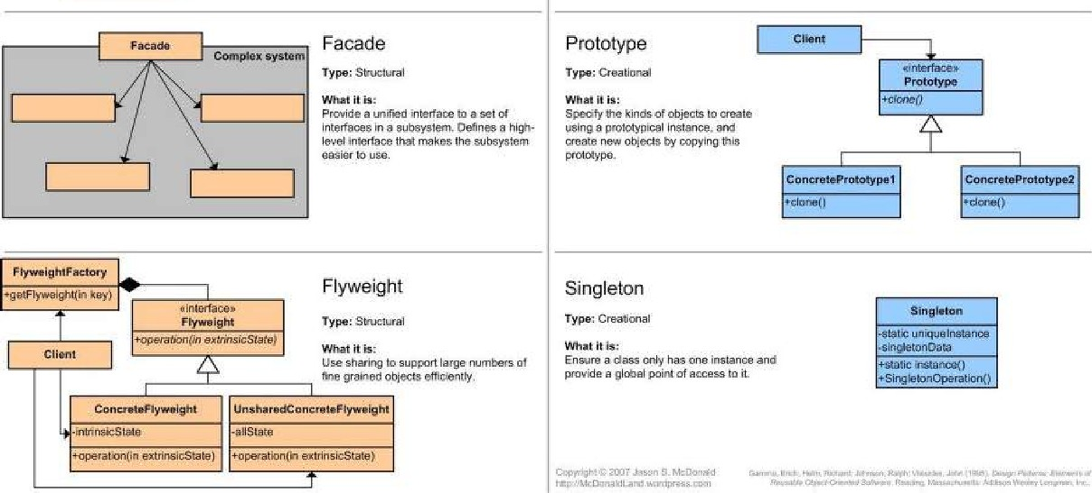
Design Heuristics: Look for Common Design Patterns
Design patterns provide the cores of ready-made solutions that can be used to solve many of software’s most common problems

Slide 13
Design Practices
Heuristics related to design attributes—what you want the completed design to look like.

Slide 14
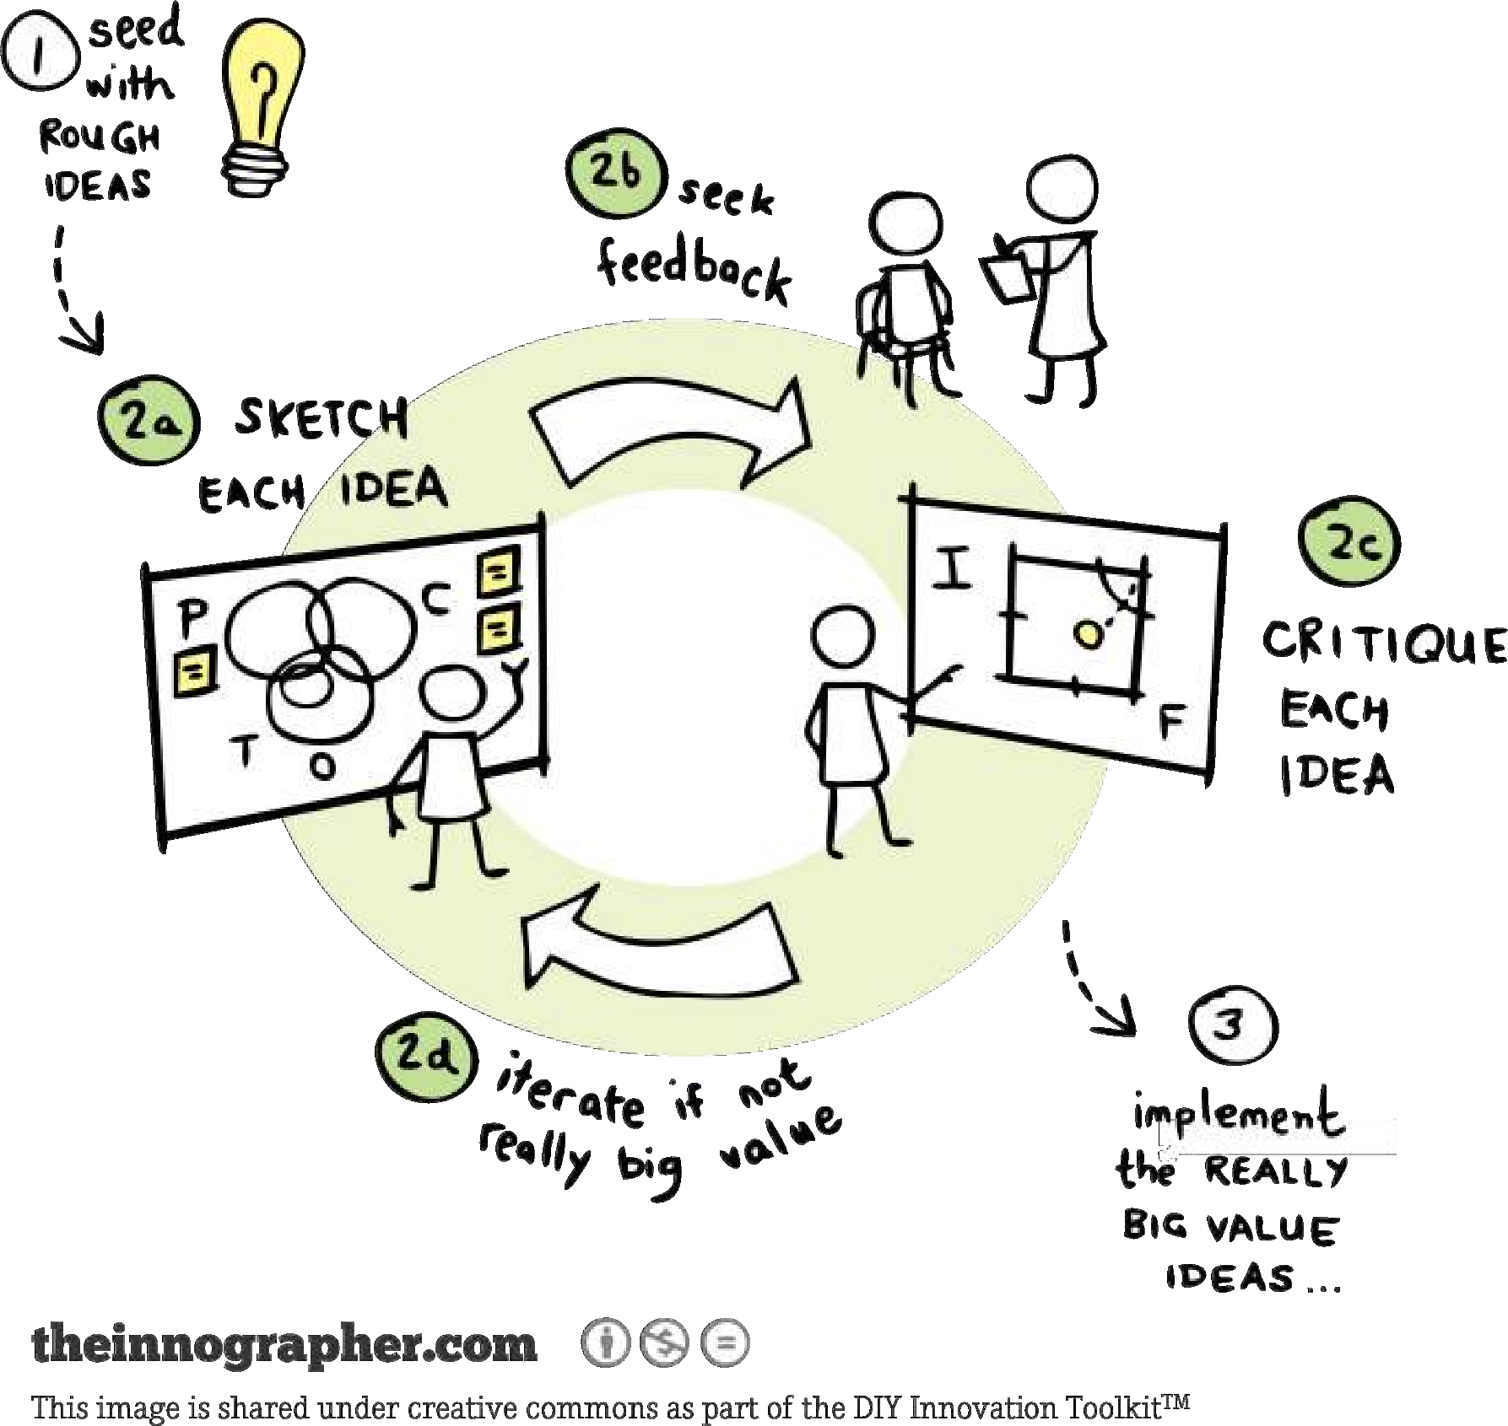
Design Practices: Iterate
Design is an iterative process. You don’t usually go from point A only to point B; you go from point A to point B and back to point A
As you cycle through candidate designs and try different approaches, you’ll look at both high-level and low-level views.
The big picture you get from working with high-level issues will help you to put the low-level details in perspective. The details you get from working with low-level issues will provide a foundation in solid reality for the high-level decisions.

Slide 15

Design Practices: Divide and Conquer
Incremental refinement is a powerful tool for managing complexity.
Divide the program into different areas of concern, then tackle each of those areas individually. If you run into a dead end in one of the areas, iterate!

Slide 16


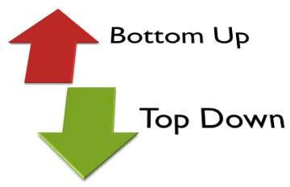
Design Practices: Top-Down and Bottom-Up
Top-down design begins at a high level of abstraction. You define base classes or other nonspecific design elements. As you develop the design, you increase the level of detail, identifying derived classes, collaborating classes, and other detailed design elements.
Bottom-up design starts with specifics and works toward generalities. It typically begins by identifying concrete objects and then generalizes aggregations of objects and base classes from those specifics

Slide 17

Design Practices: Experimental Prototyping
You can’t fully define the design problem until you’ve at least partially solved it.
Prototyping means writing the absolute minimum amount of throwaway code that’s needed to answer a specific design question.
A risk of prototyping arises when developers do not treat the code as throwaway code.

Slide 18
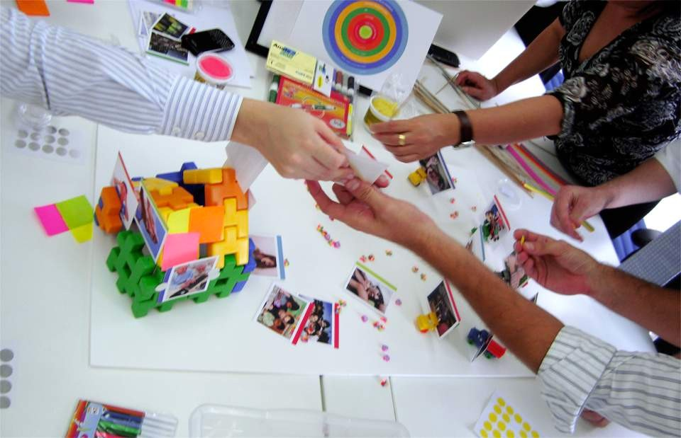
Design Practices: Collaborative Design
In design, two heads are often better than one, whether those two heads are organized formally or informally

Slide 19

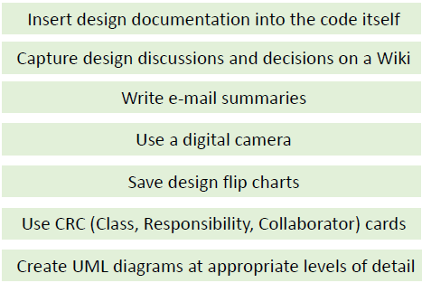
Design Practices: Capturing Your Design Work

Slide 20
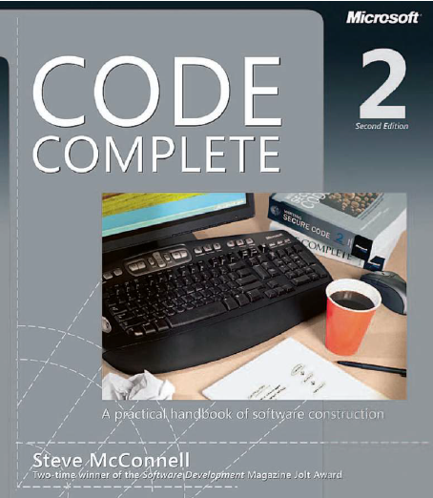
Reading
Code Complete: A Practical Handbook of Software Construction, 2nd Edition, Steve McConnell.
Chapter 5

Slide 21

Any questions? ​
Please feel free to raise your hands and ask.

